Slide 1
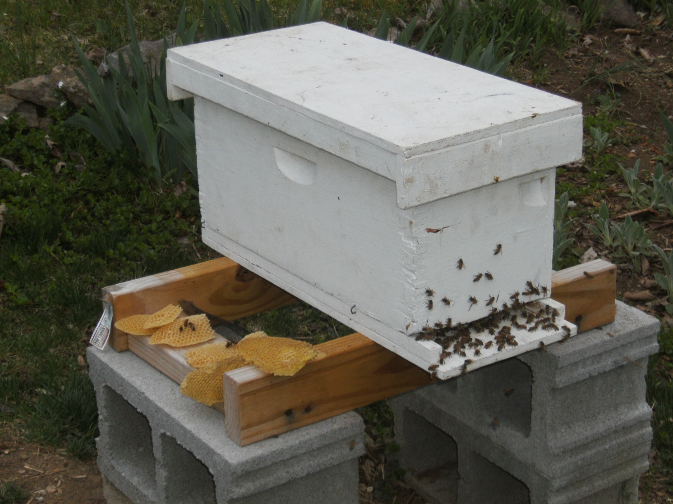
Making Splits/ Nucs
Their Use and Management
By Wes Henry

Slide 2
Why Make Splits/ Nucs?
To increase number of colonies.
Swarm Management
Make Money (Nucs and queens)
*Apiary Management (keep a nuc- “the spare-tire of the bee yard”)
To keep a queen on hand (a “known” queen for self, friend, to sell- local, available)
To have brood or extra stores to use for boosting weak or queen-less colonies.
Pull comb for replacing frames (old or damaged)
To Teach, Learn, and Experiment

Slide 3
When is the Best time to make a split?
Can make splits from Early Spring to Summer (some do make late summer splits)
Best is in spring with pollen and nectar flow (late March-June).
During “swarm season”
Why it was originally in older literature (at the advent of moveable comb) called “artificial swarming”.
But especially at a time when nectar and pollen is readily available.

Slide 4
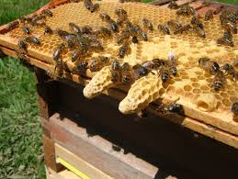
When is the Best time to make a split?
Especially when you see this!

Slide 5
Nuc Equipment
Wooden nuc box, Prefab EZ Nuc box, Double nuc box, *Full size
Size
Deeps or Mediums (Illinois Super) can be used.
Feeders
Top Feeder
Hole and jar, jar and empty box, Tupperware feeder, top feeder with floats.
Entrance feeder, Boardman feeder (best use), has a dual purpose
Division board feeder

Slide 6
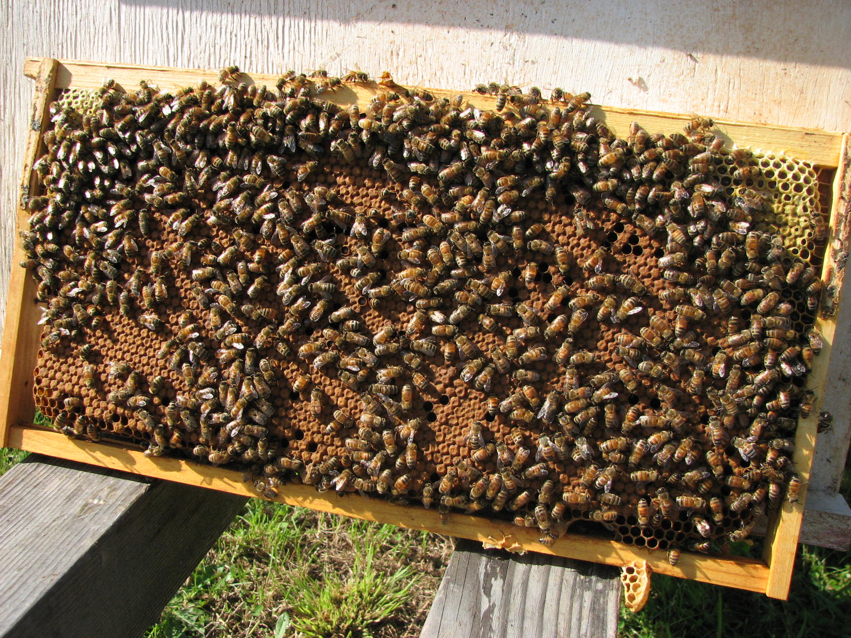
Making a Nuc- Understanding the Needs
Basic needs:
Brood capped and open,
nurse bees,

Slide 7
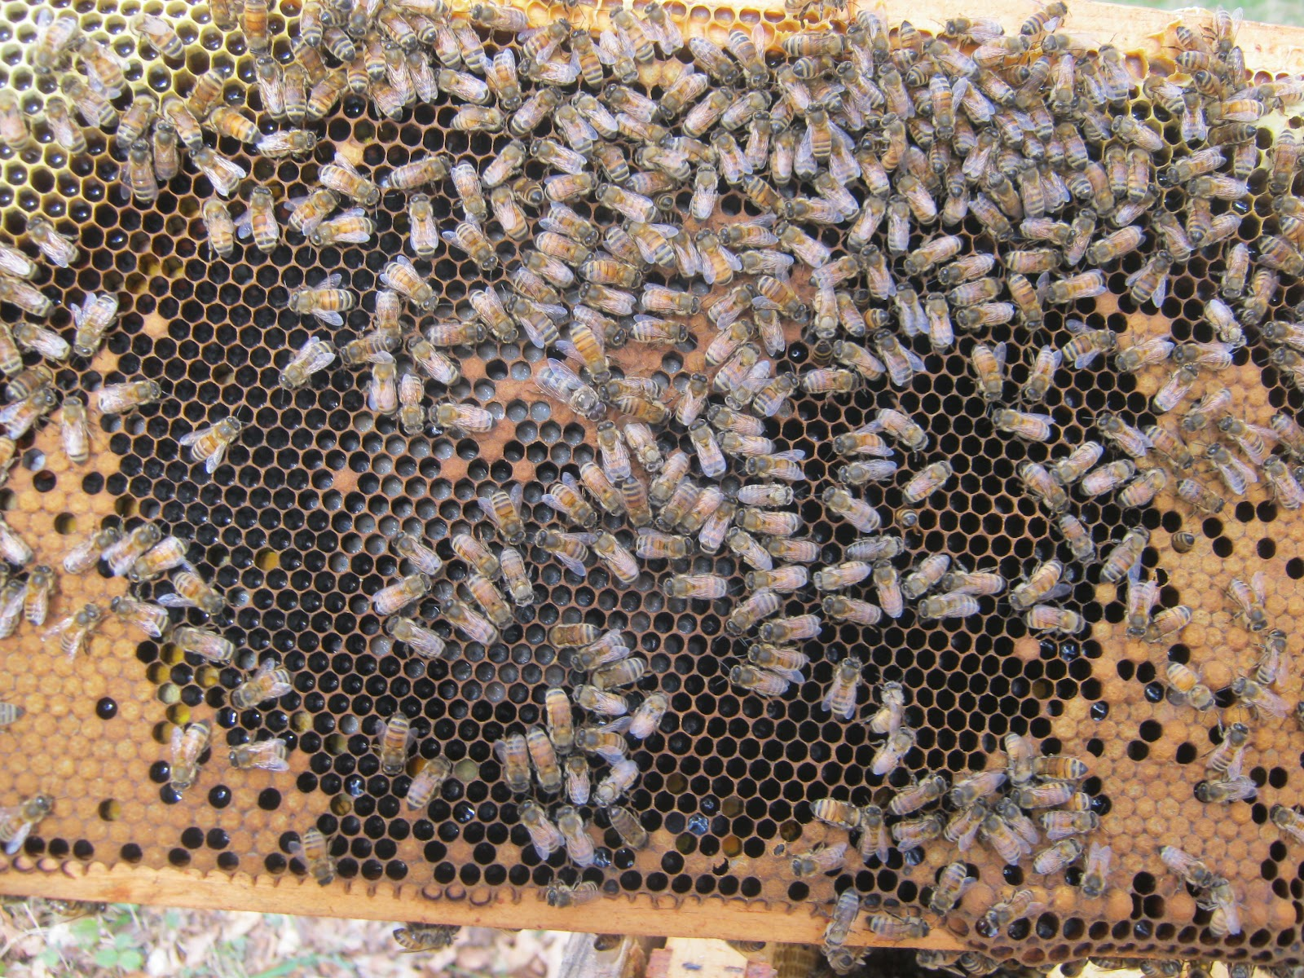
Making a Nuc- Understanding the Needs
Basic needs:
Brood (capped and open,)
nurse bees,

Slide 8
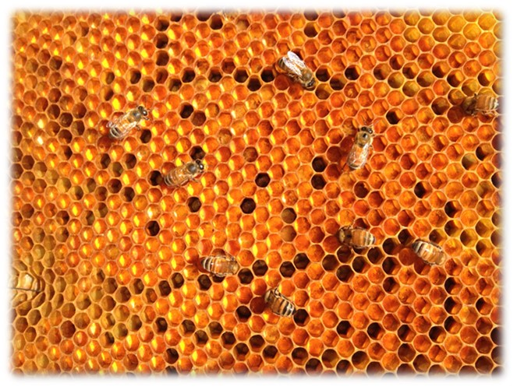
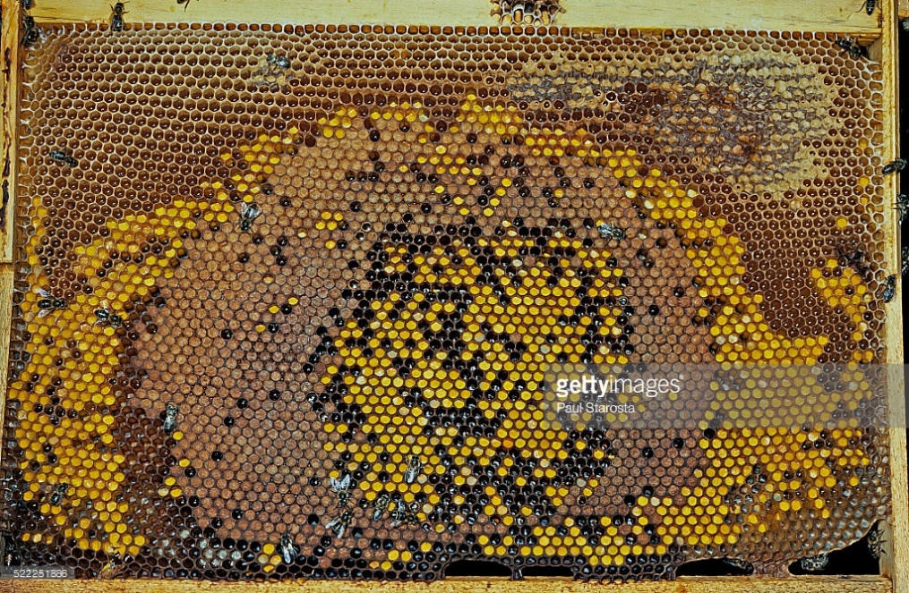
Making a Nuc- Understanding the Needs
Basic needs:
Brood, nurse bees,
pollen/honey, feed,

Slide 9
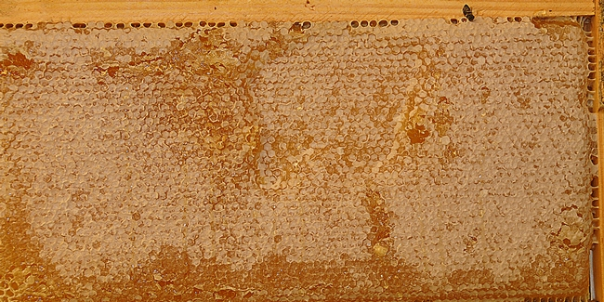
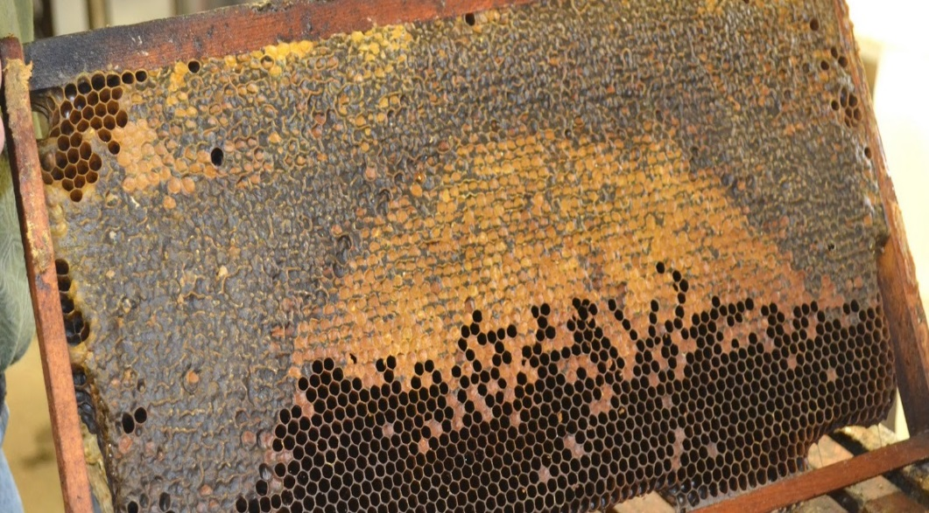
Making a Nuc- Understanding the Needs
Basic needs:
Brood, nurse bees,
Pollen & Honey, Feed,

Slide 10
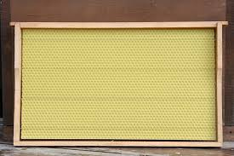
Making a Nuc- Understanding the Needs
Basic needs:
Brood, nurse bees,
pollen/honey, feed,
Room to grow,

Slide 11
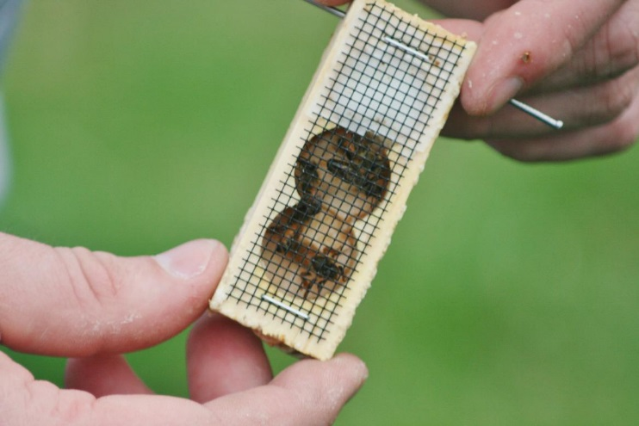
Making a Nuc- Understanding the Needs
Basic needs:
Brood, nurse bees,
Pollen/honey, feed,
Room to grow,
*Queen (otherwise your making a Frat-house)
Time Frame
Installed queen 3-4 weeks before first generation emerges.
Using a queen cell- 4-5 weeks before first generation emerges.
Making a queen- 6 weeks before first generation emerges.
*Taking the queen? (Expound on my experience)

Slide 12
Making the Nuc- Have a plan
Whats the purpose of the nuc? (increase colonies, keep for yard maintenance, selling it, queen rearing, or TBD)?
Determines equipment (frame/ hive body size, feeder, configuration, location-queen rearing, etc.)
Are you buying a queen or making a queen (time of year, speed)?
Are you using pulled comb or new foundation (maint., how fast)?
How will you feed?
Do you have feeder and feed ready?
Do you know what’s in the parent hive (do you have enough brood frames, honey and pollen frames to spare and still get honey if you want)?
Do you have replacement frames ready for the parent hive?

Slide 13
Making a Nuc- A summary of a basic Nuc
5 Frame nuc
2 frames brood all stages (egg, larva, capped, and emerging)
1 honey/pollen frame
2 empty frames (foundation and/or pulled)
*Install queen (mated or queen cell)
Feed!

Slide 14
Let’s Make a Nuc A basic and easy nuc.
Demonstration
I have a plan, equipment ready (box, frames, feed, queen), know what is in the hive.
Find the Queen!
Move two frames of brood (or one from two hives, Typically has honey on it), one of pollen/honey.
*Give a “shake”.
Add two empty frames (or 1 foundation and 1 pulled comb)
Install queen. (unless making queen)
Feed

Slide 15
Nuc Variations
5 Frame nuc (making a Queen)
2 frames brood all stages (egg, larva, capped, and emerging)
1 honey/pollen frame
2 empty frames (foundation and/or pulled)
5 Frame nuc (installing Queen)
Same as making queen but use only 1-2 brood frames (leveraging resources- make more nucs, if only 1 brood frame use some pulled comb, helps keep production hives stronger)
4 Frame and a feeder (division board feeder)
Same as five frame nuc but only one empty
2/3 Frame- Queen Nuc (Deep divided 3 or 4 ways)
1 Brood frame with honey pollen and one empty or,
1 brood frame, 1 honey pollen frame, 1 empty
Install queen cell.

Slide 16
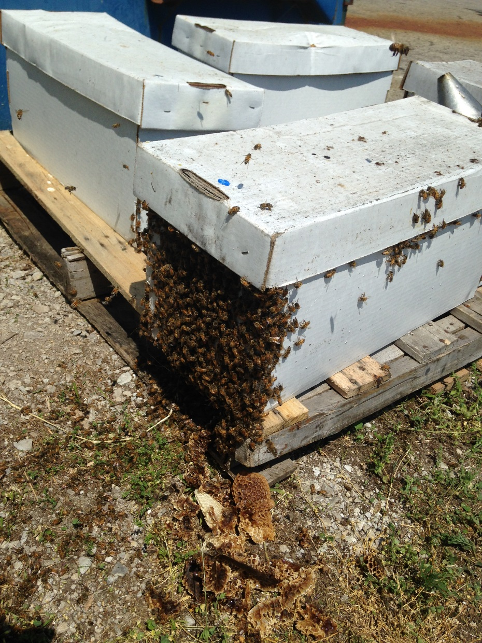
Tips for fast nuc growth
Install a Mated Queen
Use pulled comb
Feed syrup and brood supplements
Caution: Watch for swarming!

Slide 17
Nuc Management
Watch stores (feed as necessary)
Overpopulation/ Swarming (know life cycle times see chart)
Remove brood frame/ bees
Shore up weak hive, make another nuc, help a friend, etc.
Let them make honey (watch for plugging)
Eat it, Store it, use for overwintering, use to boost weak stores, etc.
Give them room/ something to do
Be prepared to overwinter or combine come fall.

Slide 18
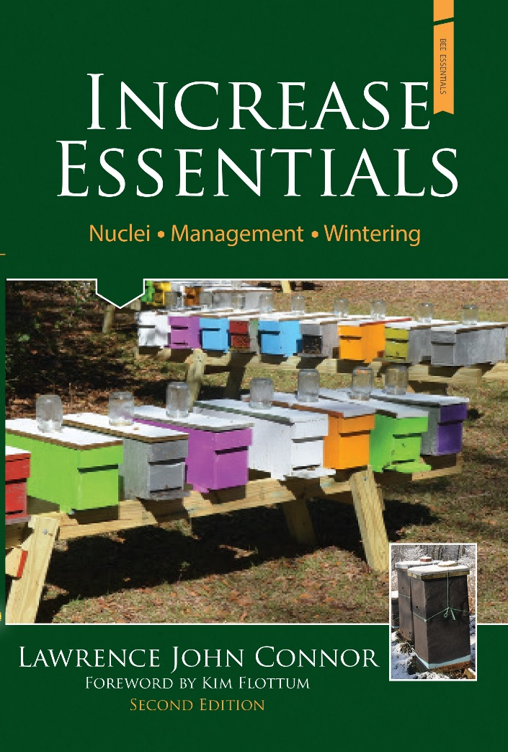
Additional Helps
Read
Larry Conner, “Increase Essentials”
Get a mentor
Ask questions
Attend schools
Join local bee club
Get out there and do it!

