Slide 1

Protect Your Bees from Varroa Mites
HEALTHY BEES, HEALTHY PEOPLE, HEALTHY PLANET.TM
Notes:
ESTIMATED TIME: 30 to 40 MINUTES, DEPENDING ON QUESTIONS ASKED, NOT INCLUDING SLIDES ON THE CONTROL TECHNIQUES.
OPTIONALLY, YOU CAN USE THE ADDITIONAL SLIDES ON TREATMENTS AT THE END OF THE PRESENTATION TO DISCUSS VARROA CONTROL TECHNIQUES.
IN THE SPEAKER NOTES, DIRECTIONS TO THE PRESENTER ARE IN BOLD AND ITALICS:
Add your name and affiliation to this title slide.
Before presenting, review the slides and speaker notes carefully. It’s a good idea to print out the speaker notes version of this presentation as a reference.
Read the Tools for Varroa Management guide and watch the varroa videos from the Honey Bee Health Coalition.
If you have internet access, open a browser and go to the site www. honeybeehealthcoalition.org/varroa. There you can link to any of the videos that you may want to show.
Show this presentation in PowerPoint’s Slide Show mode. On several slides, clicking to advance reveals additional information.
The speaker notes on the final slide includes suggested ways to respond to some commonly-asked questions.
Consider printing out copies of slide 29 as a handout for audience members. It contains the link to the Tools for Varroa Management guide and directions to find the videos on YouTube.
If you decide to use slides 30 to 38 to discuss varroa control techniques, be sure to study the Tools for Varroa Management guide and videos so you are prepared to answer questions.

Slide 2
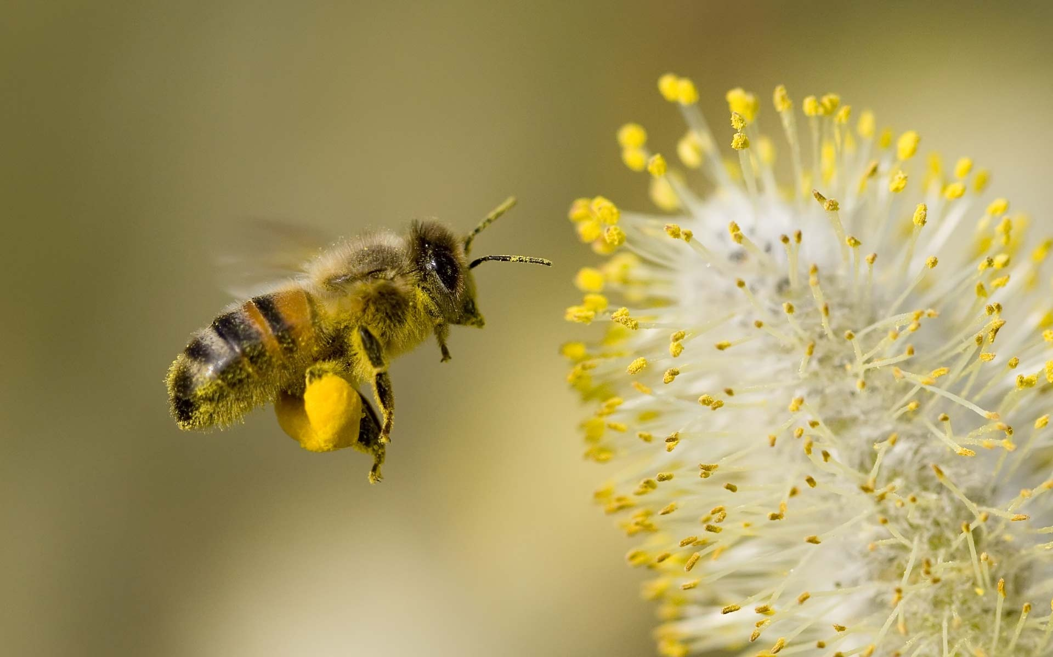
Notes:
Honey bees are an essential part of North American agriculture, but they face serious challenges today. Declines in honey bee health have been linked to a variety of factors.

Slide 3
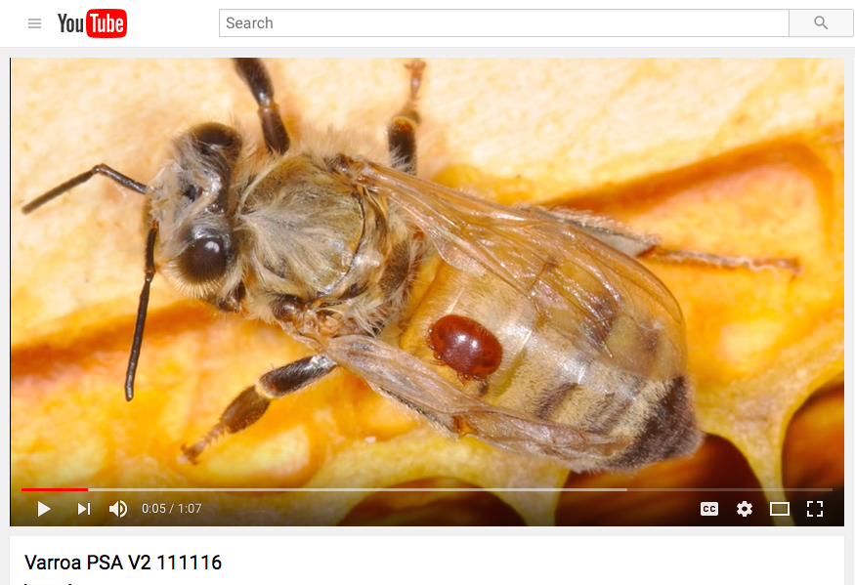
Will Varroa Mites Kill My Bees?
Notes:
NOTE TO PRESENTER: Click on the image to go to the video on YouTube.
So virtually every colony has the dreaded varroa mite. Let’s watch this video that highlights the challenges that beekeepers face.

Slide 4

WHO & WHAT is the Honey Bee Health Coalition?
Notes:
Who is the Honey Bee Health Coalition and what are we doing about bee health?

Slide 5
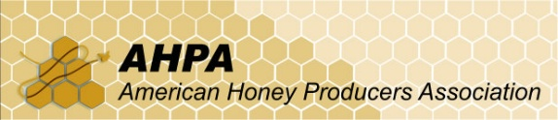

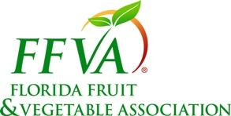


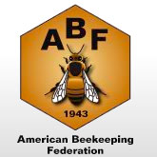
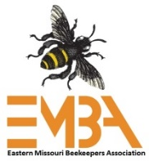
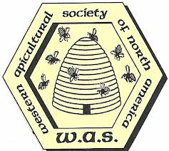
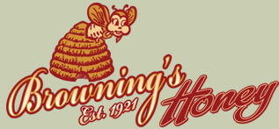








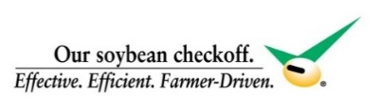


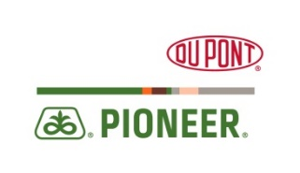


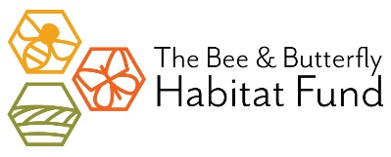

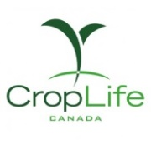

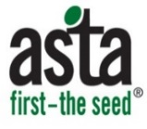
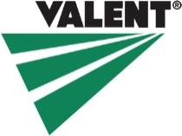



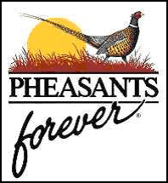
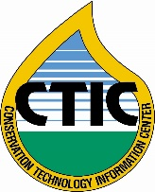

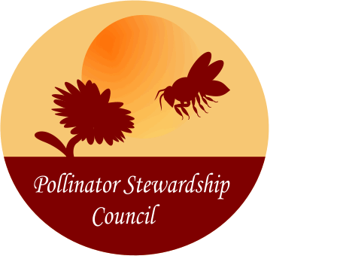






WE ARE the Honey Bee Health Coalition
HONEY BEE HEALTH COALITION MEMBERSHIP
Notes:
The Honey Bee Health Coalition, or simply HBHC, is a diverse group of beekeepers, businesses, NGOs and public/private agencies focused on finding collaborative, science-based solutions to improving the health of honey bees and other pollinators.

Slide 6
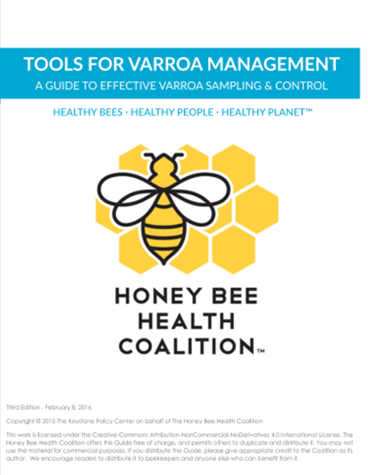
Resources: Tool for Varroa Management Guide
Download the Guide:
www.honeybeehealthcoalition.org/varroa
Notes:
The Honey Bee Health Coalition functions with task forces. One task force focuses on Crop Pest Management, another on Bee Nutrition and Forage. Our Hive Management Task Force has developed several resources to help beekeepers control varroa mites.
The Tools for Varroa Management guide offers specific information on varroa mites, sampling and monitoring of mites and an Integrated Pest Management (IPM) approach to non-chemical as well as chemical varroa control options. The Tools for Varroa Management guide is a free download.

Slide 7
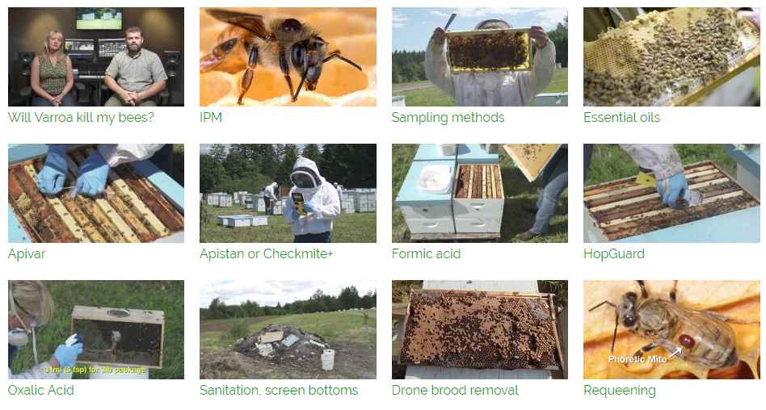
Resources: Videos
Watch the Video Series: Search YouTube for “Tools for Varroa Management Honey Bee Health Coalition”
Notes:
NOTE TO PRESENTER: If you have an internet connection, you can access the video series on YouTube by clicking anywhere on the images in this slide. The link will take you to the IPM video and the list of videos.
The Tools Guide includes a varroa video series detailing how to use recommended sampling techniques and controls. Each video is about 5 minutes long, so they are convenient to view.
They are available on YouTube. You can find them by searching YouTube for “tools for varroa management honey bee health coalition.”

Slide 8
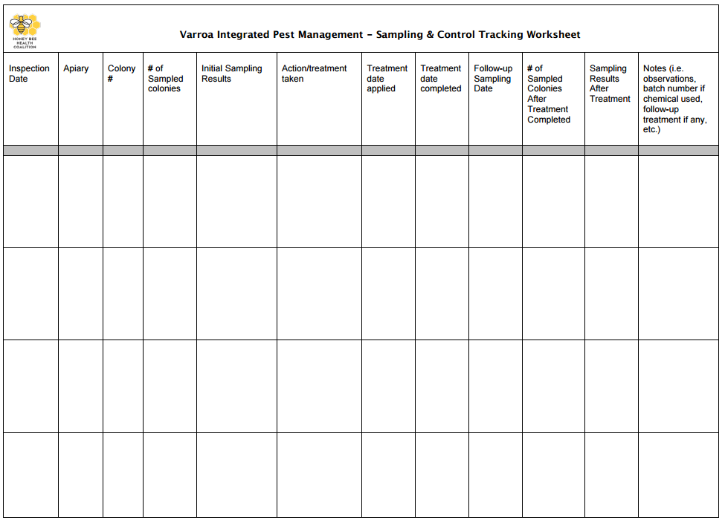
Resources: Sampling and Control Spreadsheet
Download the Spreadsheet:
www.honeybeehealthcoalition.org/varroa
Notes:
In addition, the Honey Bee Health Coalition has developed a Sampling and Control Spreadsheet which provides a handy tool for beekeepers to track their varroa mite populations, their individual control strategy and the effectiveness of applied controls. Careful measurement and tracking are important to successful implementation of Integrated Pest Management (IPM). It is also a free download.

Slide 9
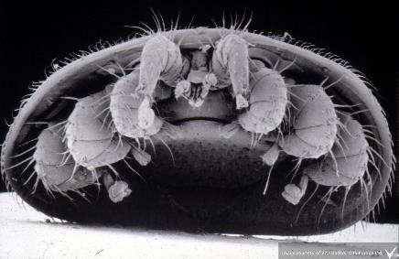
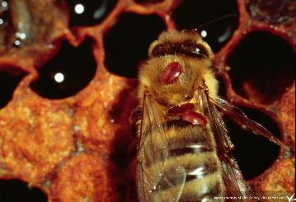
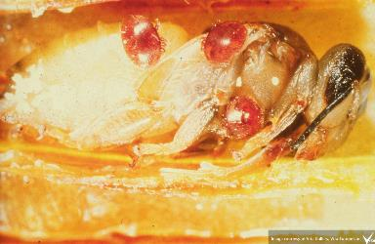
Questions & Answers
About Varroa Mites
Notes:
NOTE TO PRESENTER: The next section of this presentation is organized as a series of questions and answers. Show each question slide, ask the audience what they think the answer is, then advance to the answers slide to discuss the information.
There is information out there about varroa mites, but not all of it is accurate.
We’ll supply answers to several important questions about varroa, drawing from the Tools for Varroa Management guide might help you answer about varroa. At each question prompt, say what you think the right answer is, then we’ll see what it is.

Slide 10
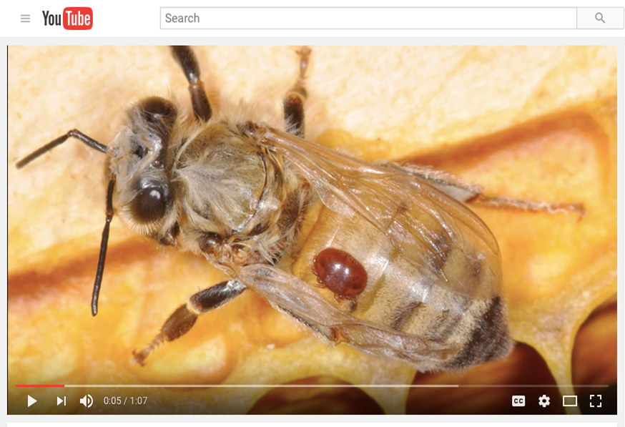
What is a Varroa Mite?
Notes:
What exactly is a varroa mite?

Slide 11
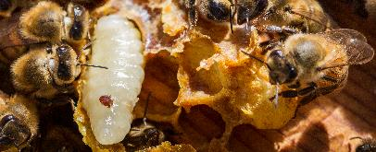
What is a Varroa Mite?
Scientific name → Varroa destructor
  Originally a pest of Asian honey bee
  Introduced to United States in 1987
  In all beekeeping countries except Australia
  Parasitizes larva and adult bees
  Vector for diseases
Notes:
The varroa mite is an 8-legged relative of the honey bee. It was originally on a Honey bee species, other than Apis mellifera, that lives in Asia. It transferred and quickly adapted to our western honey bee when the two species were maintained within the same apiaries, probably in the Philippines in the 1950 -60s. It was transferred accidently to Europe and South America and then entered the U.S. some time before 1987, when it was discovered in Wisconsin, in colonies moved to that state from Florida.
Within a few months is was discovered in an additional 10 states and today is totally distributed in all 50 states. A strictly enforced quarantine helped keep it from spreading into Canada, but following discovery in New Brunswick (1989) it is now widely spread there. It is, in fact, in all beekeeping areas of the world, except Australia (as of 2016), and lives on all bee races and selections, including the Africanized bee of the Americas.
Living up to it scientific name, it causes premature aging of adults and a less efficient worker force and death of developing pupal brood; feeding on hosts results in transmission of, and in some instances enhancement of pathogenic viruses and other bee diseases, which may subsequently reach epidemic portions and kill entire colonies.

Slide 12
True or False?
Every honey bee colony in the continental United States and Canada either has Varroa mites today or will have them within several months.
Notes:
IS this a true statement?

Slide 13
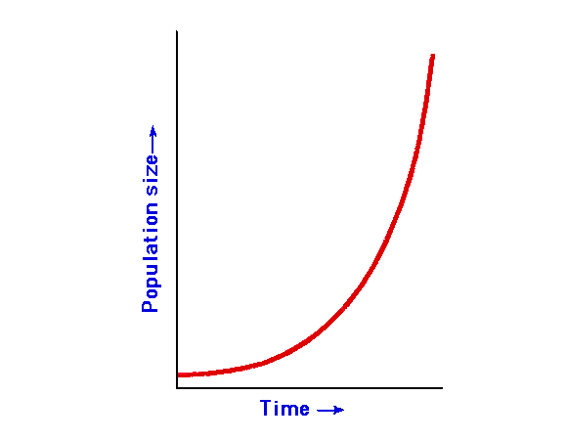
TRUE
Every honey bee colony in the continental United States and Canada either has Varroa mites today or will have them within several months. Doing nothing about varroa mites is not a practical option for most beekeepers.
We all need to accept the fact that we have an extra member of the family – the mite – and it’s here to stay.
HBHC Coalition
10%
5%
Mite
Infestation
0%
0 1 2 3 4 5
Months
Notes:
The answer is TRUE.
Mite populations, left unchecked, will grow rapidly. Colonies managed by the beekeeper or those feral colonies existing in the wild are somehow found and infested by mites. Even if you have low mite levels today, your hives can be in danger in just a few months.
Doing nothing about varroa mites is not a practical option for most beekeepers. The Tools for Varroa Management guide from the Honey Bee Health Coalition will help you to get to know varroa mites, determine numbers and how best to manage them.

Slide 14
Successful Varroa control is
________.
Notes:
Successful varroa control is ____________

Slide 15

Successful Varroa control is PROACTIVE.
We need to control Varroa before the mites reach levels that threaten colony productivity and survival.
Integrated Pest Management (IPM) is the recommended proactive strategy.
Notes:
Successful varroa control solutions are PROACTIVE. It is critical to control Varroa before the mites reach levels that threaten colony productivity and survival, rather than respond after the damage has occurred.
Integrated Pest Management (IPM) combines regular sampling of mite levels with an array of control methods, and is the approach recommended by the Honey Bee Health Coalition. We will talk more about IPM later in this presentation.

Slide 16
What are the four inter-related population phases of the honey bee/varroa mite seasonal cycles?
Notes:
Both beekeeping and mite management are seasonal. What are the four primary inter-related population phases of both honey bee host and parasitic mites?

Slide 17
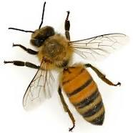
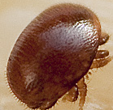
The four population phases of the honey bee/Varroa mite seasonal cycle are dormant, population increase, population peak, and population decline.
Notes:
NOTE TO PRESENTER: CLICK TO REVEAL THE HIGHLIGHTS ON THIS SLIDE.
Honey bees and their varroa mite parasites cycle through four temporal phases..
The phases are:
Dormant (technically bees don’t have a dormancy – they merely cluster around a decreased amount of brood during the coldest, rainiest part of the season)
Population Increase (often thought of as spring buildup)
Population Peak
Population Decrease (often the fall months).
The relative length of each phase depends on location (such as Florida with long increase and decrease or Manitoba with short, rapid spring increase and rapid fall decrease). In some locations, there is more than one peak period per year.

Slide 18
What percentage of mite infestation is considered potentially harmful?
%
%
%
%
%
%
%
Notes:
Do we know what number or percentage [%] of mites is harmful to bees?

Slide 19
What percentage mite of infestation is considered to be potentially harmful?
It depends on the seasonal phase.
Colony Phase | Acceptable Further control not needed | Caution Control may be warranted | Danger Control promptly
Dormant with brood | <1% | 1-2% | >2%
Dormant without brood | <1% | 1-3% | >3%
Population Increase | <1% | 1-3% | >3%
Peak Population | <2% | 2-5% | >5%
Population Decrease | <2% | 2-3% | >3%
Acceptable: Current mite populations are not an immediate threat.
Caution: Mite population is reaching levels that may soon cause damage; non-chemical control might be employed; chemical control may be needed within a month. Continue to sample and be prepared to intervene.
Danger: Colony loss is likely unless the beekeeper controls varroa immediately.
Post treatment sample percentage should be < 3%
Notes:
The number, or percentage, of mites that is considered potentially harmful depends on the seasonal phase.
The percent is a measure of probability of significant risk to continued colony profitability and survival (it does not mean if you have the specified number there is no risk). In the Peak Population phase illustrated in red outline, there are lots of adult bees and lots of brood in fully developed colonies but mite populations are still building. The danger level [colony loss is likely unless the beekeeper controls varroa immediately] is 5% (although some consider 5% TOO HIGH and believe 3% a better upper limit). Levels above 5% means an even higher risk.
NOTE TO PRESENTER: CLICK TO REVEAL THE STATEMENT ON POST TREATMENT SAMPLING %.
When sampling post treatment, mite numbers should be less than 3%. If mite numbers remain above 3% following a treatment, you should consider applying another control chemical or method without delay.

Slide 20
Why is sampling important to controlling Varroa?
Notes:
Why is sampling a critical part of an Integrated Pest Management (IPM) control approach to control varroa?

Slide 21
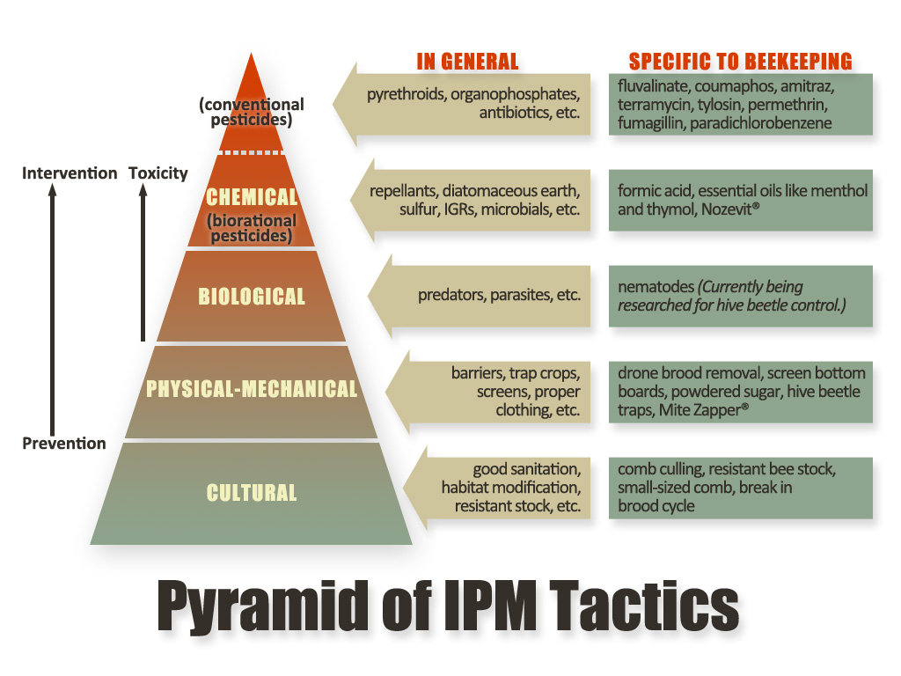
Regular sampling provides an estimate of your mite population and allows you to select the appropriate control technique.
IPM is a set of proactive, non-chemical and chemical methods that offers beekeepers the best whole systems approach to controlling Varroa.
Graphic courtesy of Penn State
IPM starts with most basic controls first.
Notes:
Integrated Pest Management relies on regular sampling of mite populations to obtain an accurate estimate of the size of the mite populations and determination of whether the mite numbers are growing or declining.
Implementing IPM means using a number of control techniques, based on sampling numbers, that seeks to use cultural, physical-mechanical means for prevention before using a chemical control. Biorational chemical controls, where available, may reduce potentially negative toxicity effects and lessen the possibility of collateral damage to the environment or bee products and often are less hazardous to the applicator.
Currently we lack an effective biological control for varroa mites.
Graphic courtesy of Penn State

Slide 22
What sampling methods does the Honey Bee Health Coalition recommend?
Notes:
Since colonies are likely to have mites, it is critical to know with some accuracy the percent mite number, and whether the number is increasing or decreasing.
What are the best methods to estimate mite populations?

Slide 23
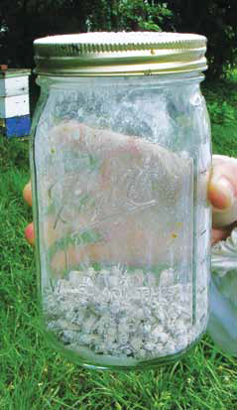
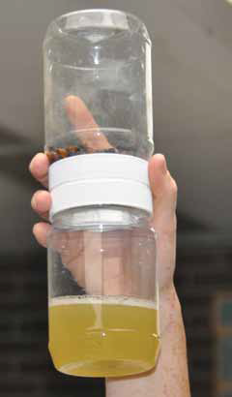
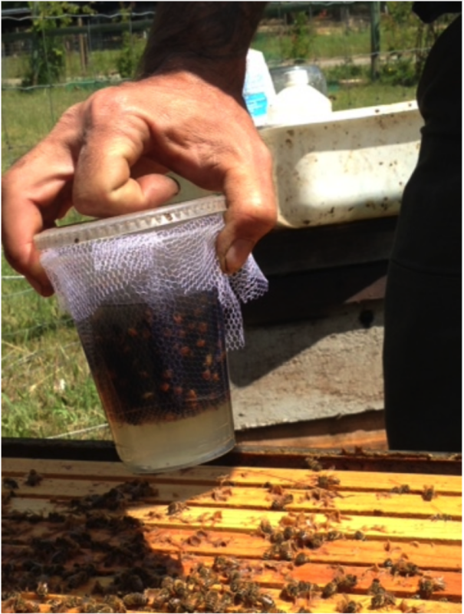
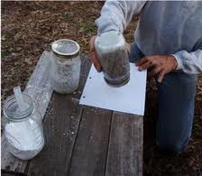
What sampling methods does the Honey Bee Health Coalition recommend?
Powdered Sugar Shake
Alcohol/Soap Wash
These sampling methods are accurate and easy to perform.
See the Tools for Varroa Management Guide and/or
the Sampling Methods video to learn how to use them.
Notes:
Removing mites from adult bees is the most accurate means of estimating the percent of mite infestation in a bee colony. The Powdered Sugar Shake and Alcohol/Soap Wash methods are two easy to use ways to do these. Details of how to use both sampling methods are found in the Tools for Varroa Management on the Sampling Methods video.
Generally, a beekeeper should sample for mites at least four times per year. Continued sampling in population decrease phase is important. You should also sample after treatments to confirm the effectiveness of the treatment.
NOTE TO PRESENTER: If people want to learn more about these methods, offer to show the Sampling Method video at the end of the meeting.
OPTIONAL EXPLANATION OF ILLUSTRATION:
The photo on the top left is a sample of 300 bees with powdered sugar; the larger photo shows shaking out the excess sugar and mites onto white surface.
The larger photo on the right shows an inexpensive double plastic cup with coarse cloth filter with rubbing alcohol used to separate the mites from the bees (see scientificbeekeeping.com for details on how to make your own sampler). The upper top right photo shows a double plastic jar with coarse wire cloth (#8 mesh) filter separating the 300 adult bee sample (top jar) and alcohol, with mites removed from the bees (bottom jar). Mites can be counted directly in liquid below.

Slide 24
True or False?
While mite densities may vary across colonies, all colonies in an apiary should be treated at the same time with the same chemical or non-chemical technique.
Notes:
This questions is a dilemma for many beekeepers: Do I have to treat ALL my colonies if even one of them has high mite numbers?

Slide 25

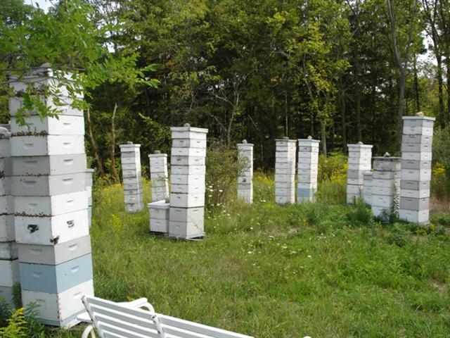
TRUE
While mite densities may vary across colonies, all colonies in an apiary should be treated at the same time with the same chemical or non-chemical technique.
Colonies with
high mite numbers
act as “mite bombs”
Notes:
While mite densities may vary across colonies, if sampling results indicate high mite populations in one colony within an apiary, all colonies in an apiary should be treated at the same time with the same chemical or non-chemical technique. Strong colonies, especially in population decrease phase, may be mite bombs spreading mites rapidly to healthy colonies.
NOTE TO PRESENTER: CLICK TO REVEAL THE ‘MITE BOMB” VISUAL
Do not delay treatment. Delay increases the risk of harm to neighboring colonies and other colonies in the area. Those colonies with high mites that are collapsing, spread their mites up to 2 miles away, via adult bees abandoning their sick colony. We call such colonies MITE BOMBS, colonies ready to implode and spread mites to other colonies in the vicinity.

Slide 26
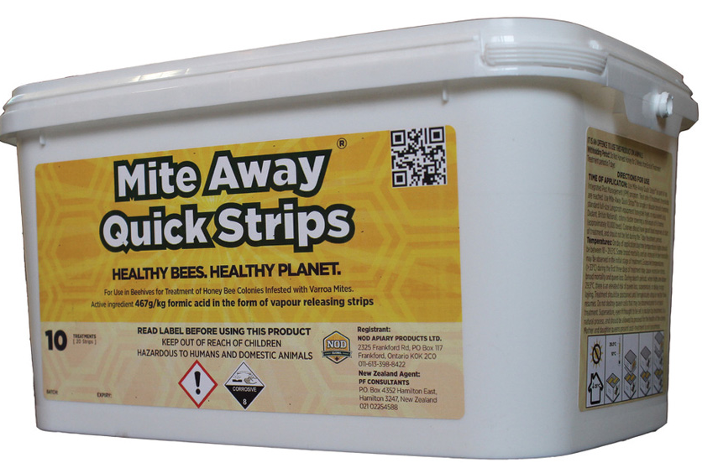
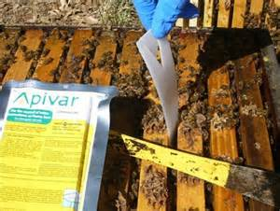
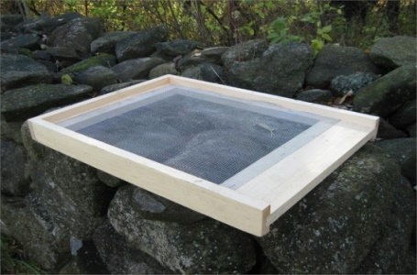
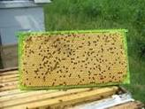
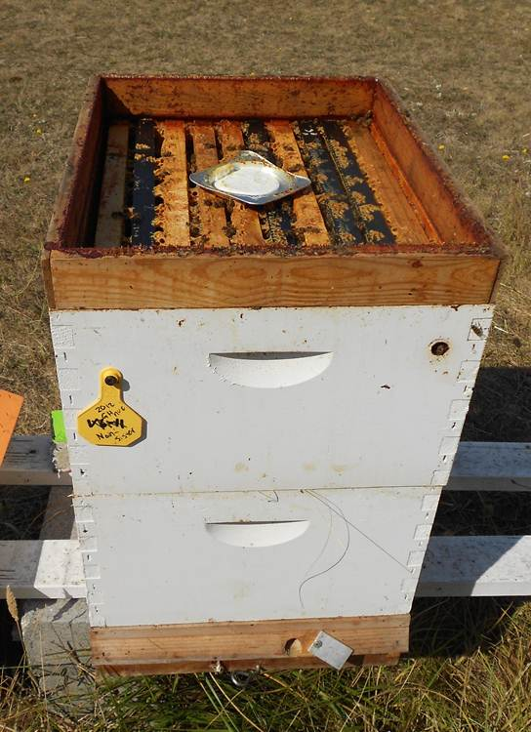
What Controls Work?
See the Tools for Varroa Management Guide and videos for more information on non-chemical treatments and chemical controls that work.
MAQS formic acid
Apivar®
(synthetic miticide)
Screened bottom board
There is no “magic bullet”
No one technique/chemical works
for everyone in all instances
Apiguard - thymol
Drone brood removal
Notes:
The Tools for Varroa Management guide and the videos cover only approved, proven-effective treatments and chemicals. No one approach or chemical will work for everyone in all situations. As new techniques or chemicals are developed, the Tools guide will be updated.
See pages 17-20 of the Tools for Varroa Management guide for descriptions of each technique/chemical and appropriate video that illustrates proper use/application.

Slide 27
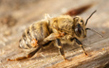
In Summary
The Varroa mite is a formidable foe.
Virtually all colonies have or will have mites.
A large percentage of colonies will not survive if the mite population exceeds 3%.
High Varroa populations (mite bombs) often result in virus epidemics that weaken or kill colonies.
Some resistant stocks are helpful but temporary fixes are still needed to keep mite populations lower.
Notes:
Review the points on the slide:
The varroa mite is a formidable foe.
It is found in virtually all colonies in North America, if not now, soon.
NOTE TO PRESENTER: The top right illustration is a bee with Deformed Wing Virus (DWV). It was infected as a larvae by a varroa mite carrying this virus. Adult bees infected with DWV do not have deformed wings but do little hive work, live much shorter lives, dying young outside the hive but also will abandon their hive, drifting into other hives, spreading the deadly virus to healthy colonies.
When the mite population grows and exceeds an infestation level of 3% (of the adult worker bee population), it, often, in association with viruses like Deformed Wing Virus (DWV), as shown in the insert, weaken and kill bee colonies.
Our ultimate solution for this serious pest is bees that can better resist the mites themselves; some stocks such as hygienic bees, UMN hybrids, new world Carniolan and VSH are helpful, but until we have consistent resistant stock, temporary fixes such as management treatments such as drone brood removal and brood breaks combined with mixture of chemical approaches in an integrated pest management approach to varroa control is necessary.

Slide 28

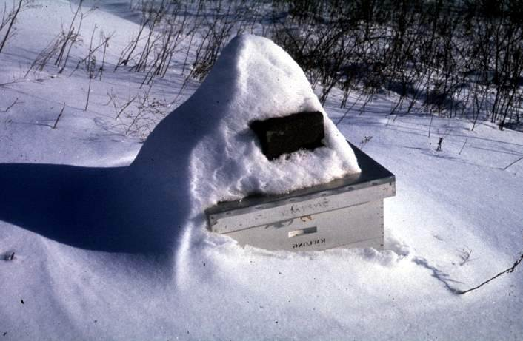
Keeping bee colonies healthy is challenging
Some seasons are going to be tough …
Bee colonies will also need to be tough
For every complex problem there is an
answer that is clear, simple and wrong.
H.L. Mencken
Notes:
Read slide, Click to reveal the quote from H.L. Mencken
The varroa mite is a formidable foe. It is more difficult to control in some seasons; unhealthy, stressed bees will be more susceptible.
Our ultimate solution will be to have bees better able to resist the mite. In the meantime we search for effective means to control the mite. The solution of some will not be appropriate for others. There is no one single solution.
As H.L. Mencken wrote ‘For every complex problem there is an answer that is clear, simple and wrong.’

Slide 29
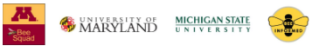
MiteCheck
Beekeeper Citizen Science
Can beekeepers become proficient at mite monitoring?
Can we update beekeepers about mite levels in their area?
Can we better understand our mite population dynamics?
www.mitecheck.com
Notes:
MiteCheck is a collaboration between the University of Minnesota, University of Maryland, Michigan State University and the Bee Informed Partnership. Research is unveiling evidence that Varroa destructor infestations over a mile from a colony couple play a role in the horizontal transmission of this pest and its associated viruses. MiteCheck is a beekeeper citizen science project that encourages all beekeepers to monitor their colonies monthly and report their mite levels to www.mitecheck.com. Monthly monitoring will increase testing proficiency and allow beekeepers to detect spiking mite populations that need management. Sharing these mite data will inform beekeepers in the area that there might be high mite infestations close to their own apiaries. Also, data sharing will allow MiteCheck to detect and investigate the mite populations in different geographical areas.

Slide 30
Thanks for your time and attention
Questions?
Download the Guide:
www.honeybeehealthcoalition.org/varroa
Watch the Video Series: Search YouTube for “Tools for Varroa Management Honey Bee Health Coalition”
Notes:
NOTE TO PRESENTER: If you want to show the videos at this point in the session, click on “Watch the Video Series” to access the videos on YouTube.
What questions do you have about protecting your bees from varroa mites?
Thank you for your time today. Good luck with your varroa management practices.
Please take advantage of the resources from the Honey Bee Health Coalition.
NOTE TO PRESENTER ON QUESTIONS:
Early questions you might expect are basically some variation of the question “I don’t need or want to control mites”, such as:
Why do all this work? I have had bees for XX years and they are doing just fine
I don’t want to use chemicals in my bees, so why do I need to sample and control mites?
Beekeeper XYZ has never done any mite control and he isn’t losing colonies.
These are tough questions to answer. Be prepared. Indicate that yes, there is variation and yes, we do hear of some beekeepers who apparently are not doing control and they are [perhaps] not losing colonies. Most of us are losing colonies however and mite control is key to reducing such losses. Bees are not wild animals – they benefit from our care.
You may also get questions on non-chemical techniques (such as powdered sugar dusting, mineral oil misting), other essential oils besides thymol, or the latest internet control “sensation”. Advise caution on using untested treatments. If someone insists on trying them, advise testing on one or a few colonies to determine effectiveness (sampling pre and post application). Remember, if it sounds ‘too good to be true’ it probably is.
Emphasize that using any chemical not registered as a mite control is illegal, regardless of its effectiveness.

Slide 31
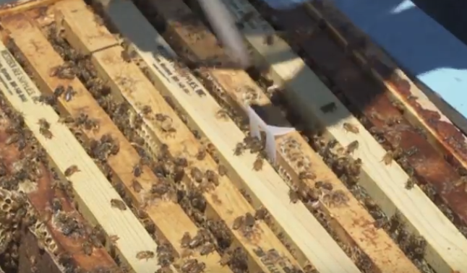
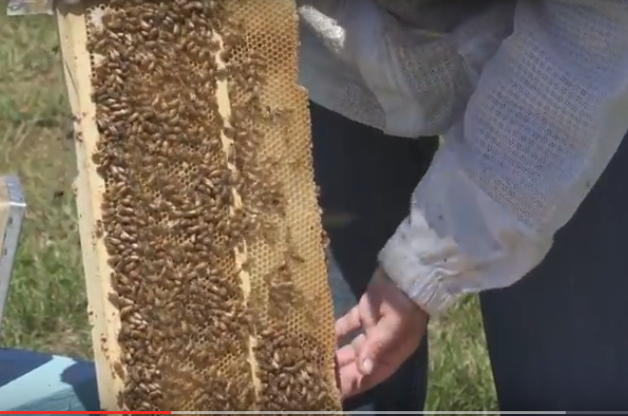
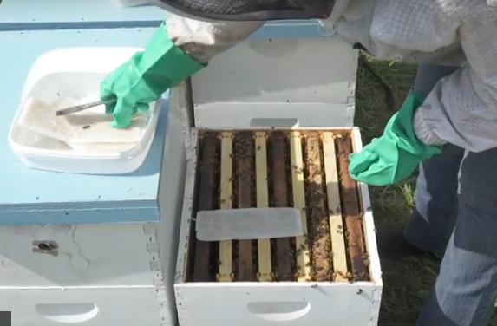
Additional Slides on Treatments
Notes:
If you want to extend your presentation to discuss several varroa treatment options, use the following slides.

Slide 32
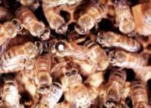
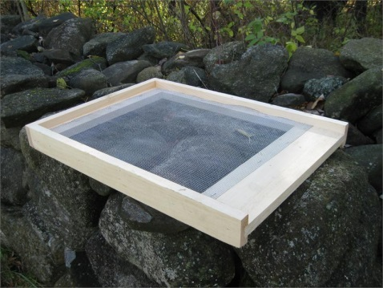
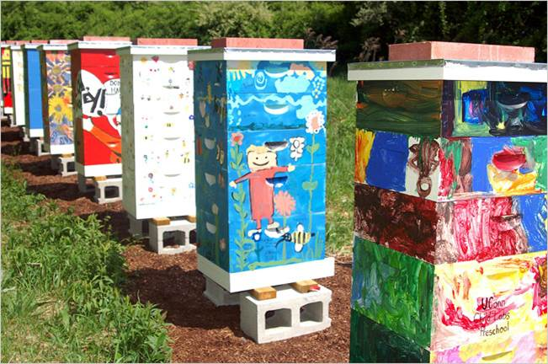
Non-chemical Cultural
& Mechanical-Physical Controls
More Effective
Drone brood removal
Brood interruption
Requeening
Minimally Effective
Screen bottom board
Comb culling
Powdered sugar
Apiary site
Colony ID/configuration
Basic sanitation
Drone brood removal
Requeening
Screen bottom board
Colony configuration
Notes:
NOTE TO PRESENTER: See the information on these controls in the Tools for Varroa Management guide and videos so you can discuss them.
OPTIONAL EXTENDED NOTES TO PRESENTER: Cultural or mechanical-physical control devices (traps) may be less expensive, but are also tend to be less effective control measures. These techniques should be used with other controls in an Integrated Pest Management plan. Most can be combined with other bee managements during the appropriate season.
The three more effective approaches are labor-intensive.
Drone brood removal: Not as effective as a stand-alone treatment. Repeating 2 to 3 times during population increase phase compounds effectiveness.
Brood Interruption; Little data on its effectiveness as a stand-alone treatment.
Requeening: Long-term solution to reduce need for chemical controls. Works well when combined with other methods.
Less effective measures
Screen bottom board: This low tech method reduces mites in colonies by less than 10%. Combined with a sticky board it can help to monitor trends in the mite population as a back-up check to confirm the adult bee sampling with powdered sugar or alcohol wash.
Comb culling: Eliminating 2-3 of the oldest, darkest brood frames per box helps reduce the pathogen load in a colony, but is not an effective mite reduction technique.
Powdered sugar: Powdered sugar is a great tool for sampling mites but is not effective for mite control.
Apiary site: Arranging bees in irregular patterns and providing as much spacing between colonies as possible is helpful to reduce drifting.
Colony configuration: Arranging colonies in irregular patterns, with plenty of landmarks for individual colonies to recognize their own home also reduces drifting.
Basic sanitation: Washing hive tools between colony inspections, avoiding transfer of frames and/or bees between colonies, holding weak, struggling colonies or those that do not appear healthy in a “hospital” yard, curing chalkbrood, reducing pest damage, etc. are all basic sanitation we should practice. Their effectiveness at controlling varroa mites is unknown.

Slide 33
Synthetic Chemical Treatment: Apivar®
amitraz
What is common name for Apivar®?
What is its route of exposure?
Can it be used when supering?
What is treatment interval?
What about disadvantages?
Contact
No
42-54 days
Brood loss,
mites developing resistance
Notes:
NOTE TO PRESENTER: Click to reveal the answers to these questions, one at a time.

Slide 34
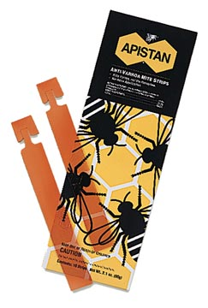
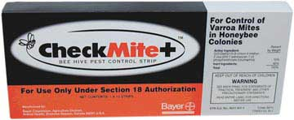
Two Older Synthetic Chemical Treatments
What is the active ingredient of Checkmite®?
What about Apistan®?
What are major disadvantage of these two treatments?
Coumaphos
Tau-fluvalinate
Mite resistance, Beeswax contamination,
Kill queens,
Long half-life
Notes:
NOTE TO PRESENTER: Click to reveal the answers to these questions, one at a time.
EXTENDED NOTES TO PRESENTER:
These two compounds, once widely used, are no longer effective as mites have developed resistance to both. Checkmite+® (coumaphos) is used for small Hive Beetle control. Some beekeepers have “returned” to use Apistan® and seem to have some effective control for one or more seasons; however the pesticide tau-fluvalinate is a major hive, bee and beeswax contaminate and other negative effects have been described.
A post treatment sample is absolutely necessary if either of these two compounds are used to control mites.

Slide 35

Essential Oils Treatments
API LIFE VAR®
APIGUARD®
What is the main essential oil ingredient of both products?
What is the route of exposure for these products?
What is an advantage of these product?
What are issues when using these products?
Thymol
Fumigant
Naturally derived
Temperature
Brood/queen loss
Notes:
NOTE TO PRESENTER: Click to reveal the answers to these questions, one at a time.

Slide 36
Acid Treatments: Mite-Away Quick Strips® (MAQS®)
What is the active ingredient of this treatment?
Route of exposure
What are two major advantages of this product?
What is treatment time?
What considerations does the beekeeper have to keep in mind?
Formic acid
Fumigant
Kills mites under caps & can use when supering
One week (7 days)
Temperature; personal protection essential: gloves, eye wear, respirator recommended
Notes:
NOTE TO PRESENTER: Click to reveal the answers to these questions, one at a time.
EXTENDED NOTES TO PRESENTER:
Mite Away Quick Strips (MAQS) is a formic acid gel strip. It has the unique penetrating action of a fumigant that enters under the cappings of brood and kills the reproducing mites. It is a treatment that only requires 7 days – the shortest of all the chemical pesticides. This acid is corrosive so protective equipment is required (respirator recommended). It can be effectively used in temperatures between 50 and 85 degrees.

Slide 37


Acid treatments: Oxalic
vaporizer
What is the mode of action?
What are the methods of application?
What time of year should this product be applied?
When should this product be used?
What about disadvantages?
Contact
Spray, dribble & vapor
Dormant phase,
late Population Decrease
Apply when colony is broodless
Corrosive; must use safety equipment, including respirator
Notes:
NOTE TO PRESENTER: Click to reveal the answers to these questions, one at a time.
EXTENDED NOTES TO PRESENTER:
The newest control chemical is Oxalic acid. A contact miticide, It is approved in three application methods – spray for packages, dribble for clustered bees during dormant phase or with a tool to vaporize the acid. It does not penetrate the cappings so it is recommended to use during the dormant phase or when little or no capped brood is present. Like other acids it is highly corrosive and MUST be used with proper safety equipment of goggles, acid resistant gloves and when using a vaporizing tool, a respirator. We are learning how best to integrate Oxalic acid into our control but it appears to work best as an end-of-the-season chemical to insure the bees begin their spring with a very low mite populations.

Slide 38


Hopguard®
An acid derived from the aromatic beta acids of hops
Cardboard impregnated strips
Dormant phase; works best if bees are broodless
“Messy” product still in development (legal to use); goggles, waterproof gloves, proper clothing required.
What is it?
What is the method
of application?
When should this product be applied?
What are the issues?
Notes:
NOTE TO PRESENTER: Click to reveal the answers to these questions, one at a time.
EXTENDED NOTES TO PRESENTER:
Hopguard® from BetaTec, although a bit “messy” as currently marketed, may be of some value when used during broodless period (dormant phase).
Personal Protection Equipment (PPE): Applicators and other handlers must wear appropriate protective eyewear, such as face shield or goggles long sleeved shirt and long pants, waterproof gloves and shoes plus socks.

Slide 39
Other Chemicals
Other chemicals are not recommended by the Honey Bee Health Coalition
  Only use pesticides registered with EPA for control of varroa mites
  Using non-approved treatments is illegal
    They may be dangerous to beekeeper and/or bees
If a chemical sounds too good to be true,
it probably is.
Notes:
There are other techniques and control methods that are not recommended by the Honey Bee Health Coalition. HBHC ONLY recommends treatments that are registered for control of varroa mites.
Use of any treatment not registered for control of varroa mites is illegal, regardless of its effectiveness.
Remember if it sounds ‘too good to be true’ it probably is.

