Slide 1
Introduction to Beekeeping

Slide 2
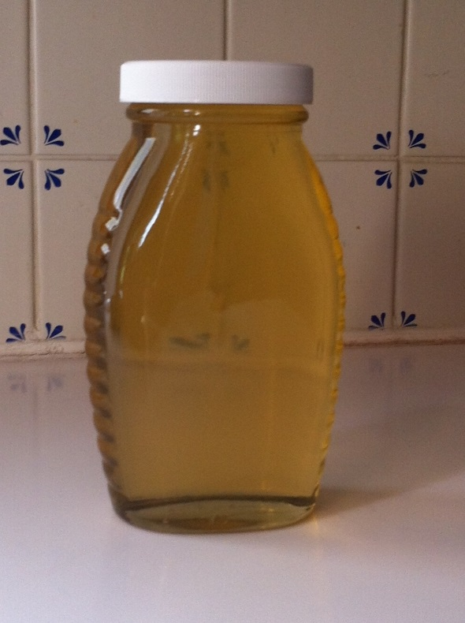
Why Keep Bees?
People take up beekeeping as a Hobby for many reasons:
Honey,
Environmentally aware and want to help,
pollination of crops,
want a hobby and get outdoors,
Education
be a bit more self reliant (honey, wax, propolis, mead,)
make money (honey, wax, pollen, pollination, bees)?

Slide 3
Three major hive products
Honey
Wax
Pollen

Slide 4
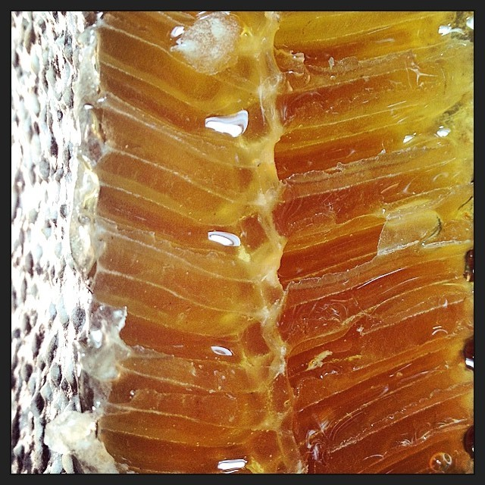
Honey: It is made not collected.
Honey gets its start as flower nectar, which is collected by bees, naturally broken down into simple sugars and stored in honeycombs.
The unique design of the honeycomb, coupled with constant fanning by the bees’ wings, causes evaporation to take place, creating the thick, sweet liquid we know as honey.

Slide 5
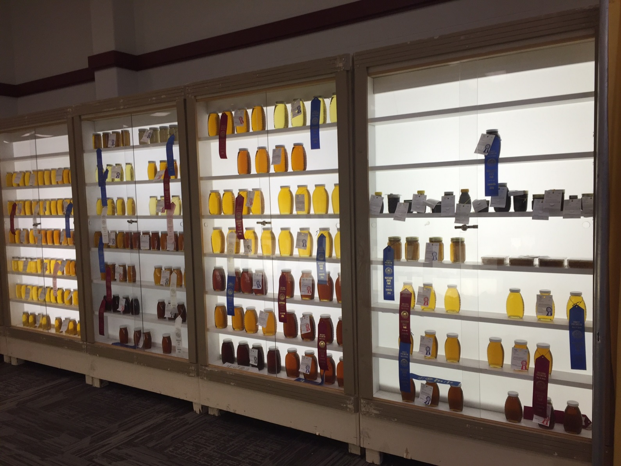
Honey: It is made not collected.
The color and flavor of honey varies from hive to hive based on the type of flower nectar collected by the bees.
It takes 12 workers to make a teaspoon of honey.

Slide 6
How is wax made?
Worker bees, which live only around 35 days in the summer, develop special wax-producing glands on their abdomens (segments 4-7)
They are most efficient at wax production during the 10th through the 16th days of their lives.
From about day 18 until the end of its life, a bee's wax glands steadily decline.
Bees consume honey causing the special wax-producing glands to covert the sugar into wax which is extruded through small pores.
The wax appears as small clear flakes on the bees' abdomen. The bees chew the wax to help soften it causing it to change color and shape it into comb and honey cappings.

Slide 7
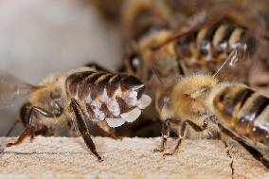
How is wax made?
It requires 6-8 pounds of consumed honey to produce 1 pound of wax.
Uses include:
Candles, comb foundation, crayons, waterproofing, coating thread, lubricate furniture joints, grafting wax for plants, furniture polish, preventing rust on tools, cheese waxing, lip balms, soaps, slaves and cosmetics, and many more.

Slide 8
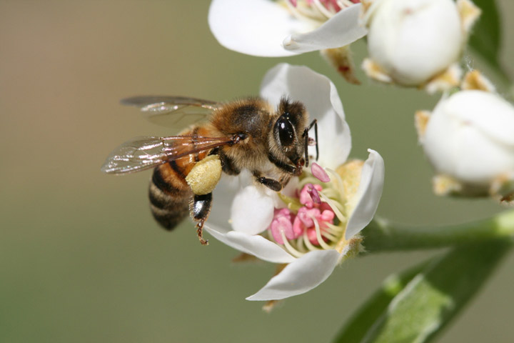
Pollen?
Collected from plants, pollen sticks to the hairs covering the bee’s body and as the bee grooms herself packs it into it pollen sacs on its legs.

Slide 9
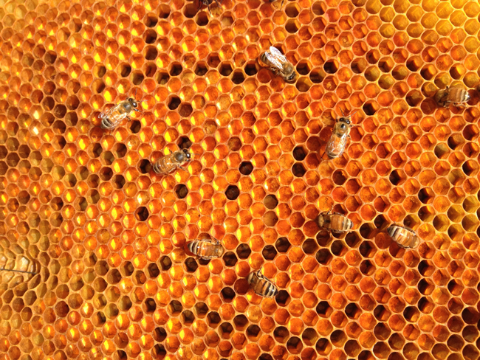
Pollen?
Collected from plants, pollen sticks to the hairs covering the bee’s body and as the be grooms itself packs it into it pollen sacs on its legs.
It is the essential protein bees need to feed brood, high in protein and other nutrients.

Slide 10
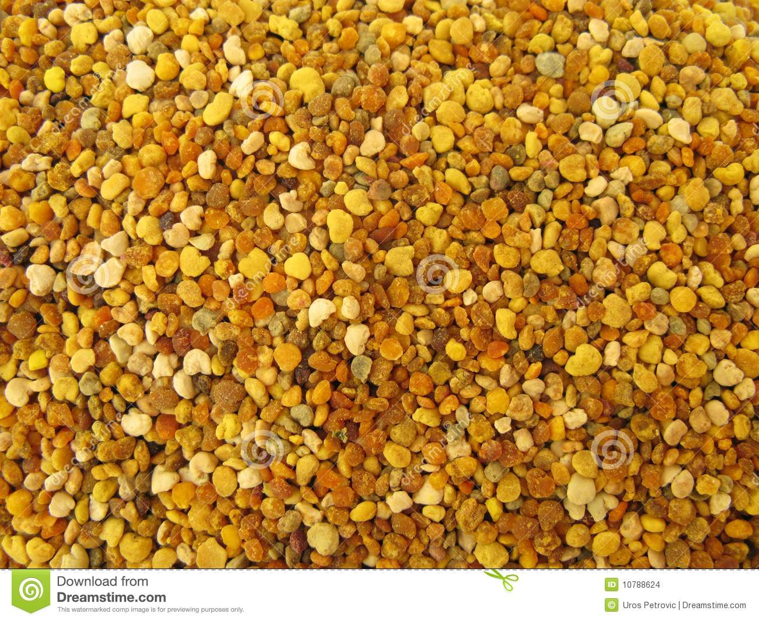
Pollen?
Collected from plants, pollen sticks to the hairs covering the bee’s body and as the be grooms itself packs it into it pollen sacs on its legs.
Is the essential protein bees need to feed brood, high in protein and other nutrients.
Also collected by some beekeepers for human consumption.

Slide 11
Pollen?
Collected from plants, pollen sticks to the hairs covering the bee’s body and as the be grooms itself packs it into it pollen sacs on its legs.
Is the essential protein bees need to feed brood, high in protein and other nutrients.
Also collected by some beekeepers for human consumption.
Found in health food stores.
Believed by herbalists to help with allergies, asthma, health maintenance, stomach problems, even the affects of chemotherapy

Slide 12
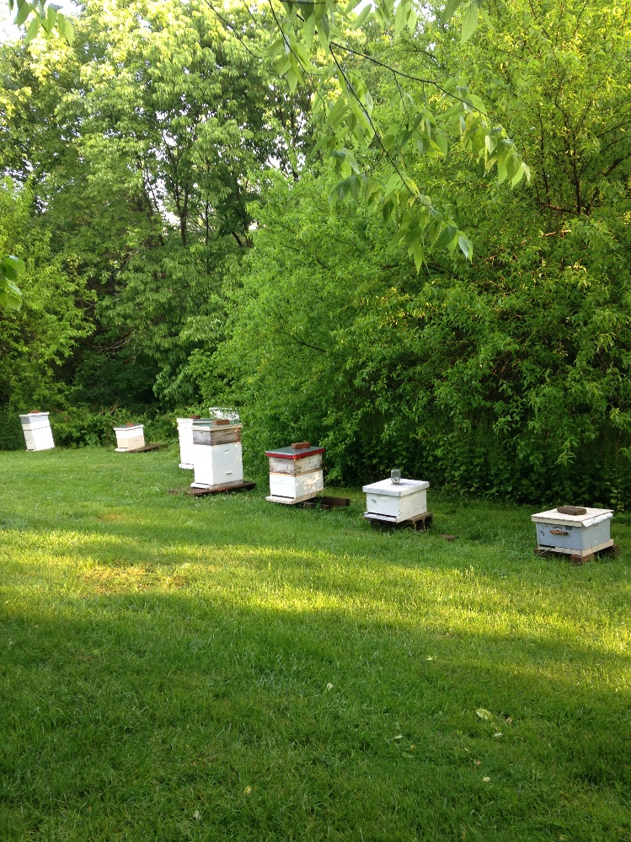
Where can I keep Bees?
Almost anywhere.
Country (ideal)

Slide 13
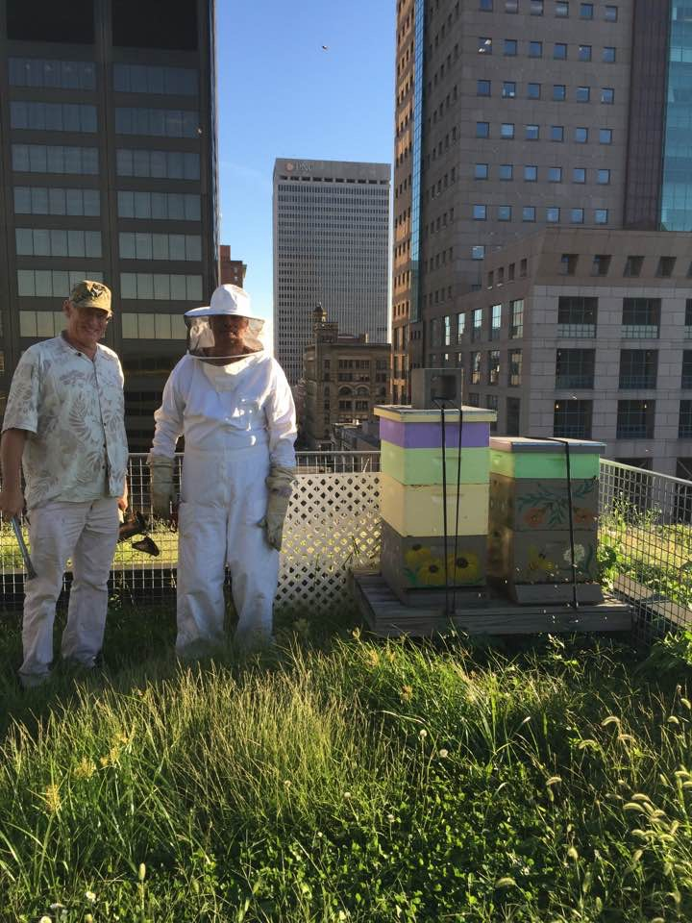
Where can I keep Bees?
Almost anywhere.
Country (ideal)
City (rooftops)
(Jens Bassburg, Downtown Louisville)

Slide 14
Where can I keep Bees?
Almost anywhere.
Country (ideal)
City (rooftops)
Suburbs (backyard, be considerate)
Let your neighbors know
Consult local laws, HOA’s, etc
Give neighbors some honey.

Slide 15
What do you think is one of the biggest questions asked of Beekeepers?
Do you get Stung?
YES

Slide 16
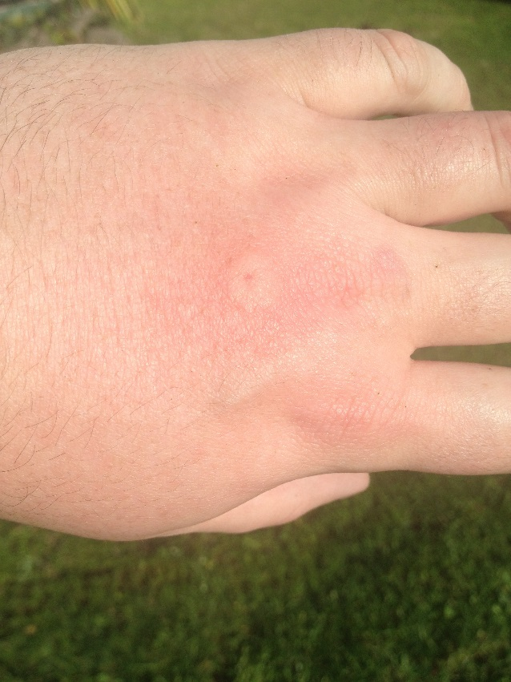
What is the normal reaction to a bee sting?
In many cases, there's only minor pain and swelling
at the sting site.
For mild to moderate reactions, treatment involves
removing the stinger, washing the area with soap
and water, and applying cold compresses or ice.
Creams to the affected area can help reduce
discomfort.

Slide 17
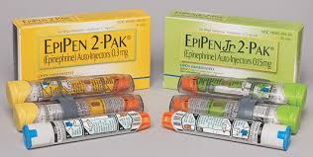
In rare cases, a life-threatening allergic reaction (anaphylactic shock) can cause difficulty breathing, tongue swelling, nausea, and unconsciousness. This may require emergency medical attention.
Severe reactions may need epinephrine, for example with an Epi-Pen.

Slide 18
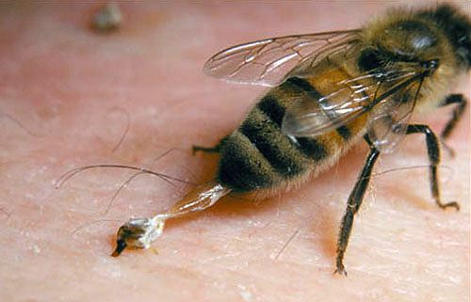
Understanding Stings
When a bee stings she dies.
Bees sting when threatened, stepped on, pinched, hive opened, sudden movements, etc..
We use smoke to calm them opening the hive.

Slide 19
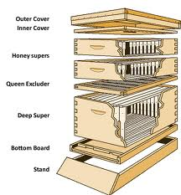
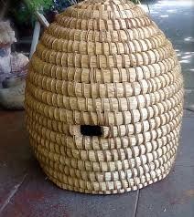
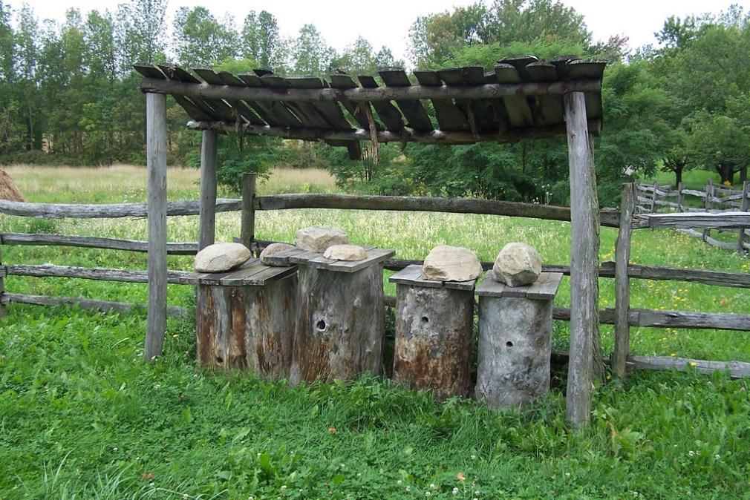
Equipment
Equipment
Honey was once harvested from feral hives
Bees used to be kept in Skeps
Bees were kept in logs or gums.
Fact: it is illegal to keep bee if not of moveable comb.

Slide 20
Cost To get started
Expect $300-400.00, equipment and bees starting from scratch
Some equipment like tools are not purchased often, some can last a lifetime.
It can be less expensive if you buy unassembled/ unpainted equipment.
It can be more if you buy assembled and painted equipment.

Slide 21
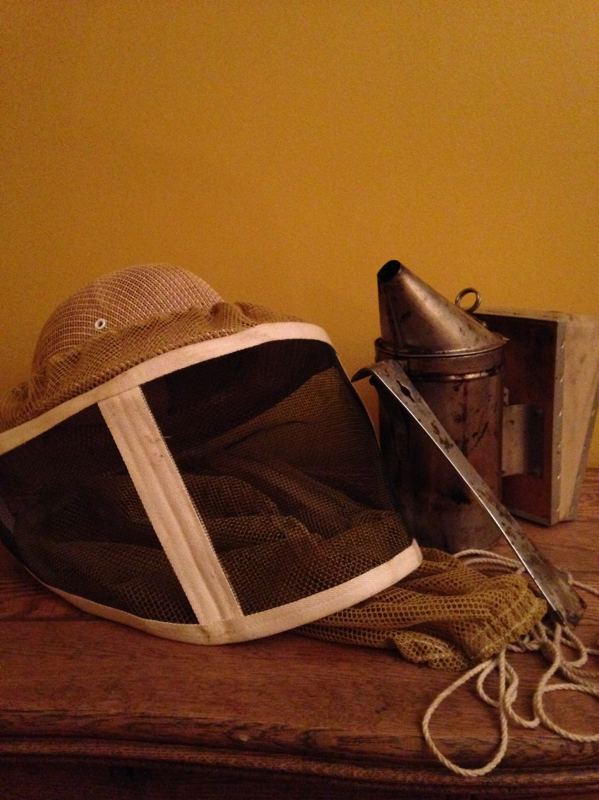
Equipment
Beyond the hive there are basic tools and clothing.
Veil/ Suit, Smoker, hive tool and gloves are essential.
There will be other tools you will want to acquire. Those will be covered in the equipment course.

Slide 22
Of course you need the Bees: Acquiring Bees
There are three methods for acquiring bees:
Packages
Nuc (nucleous hive)
Swarms (natural or artificial/ splits)

Slide 23
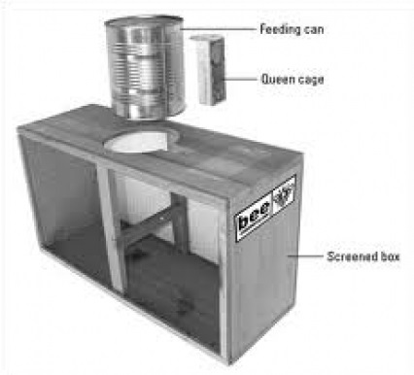
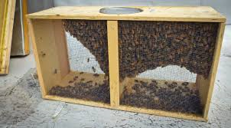
Of course you need the Bees: Acquiring Bees
Anatomy of a “Package of Bees”

Slide 24
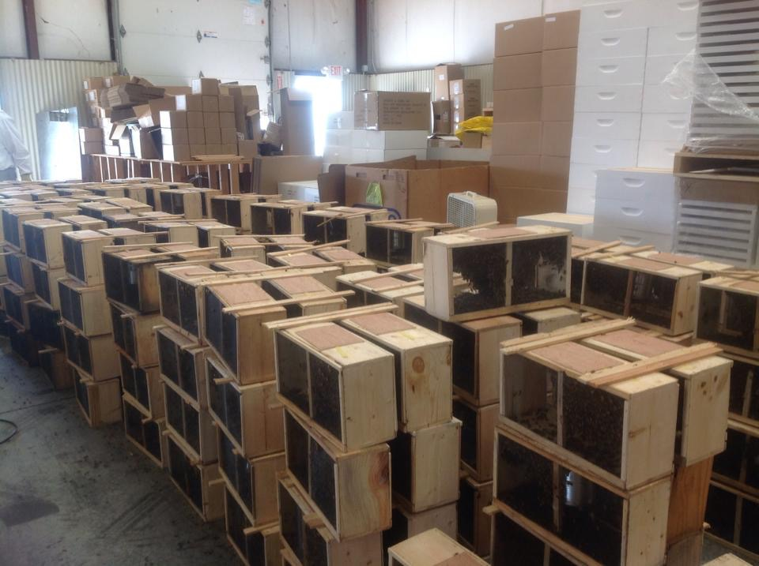
Package Day!!

Slide 25
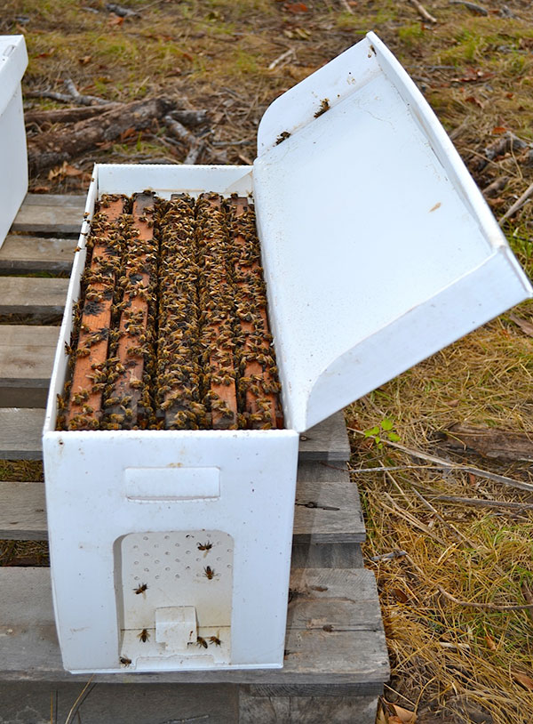
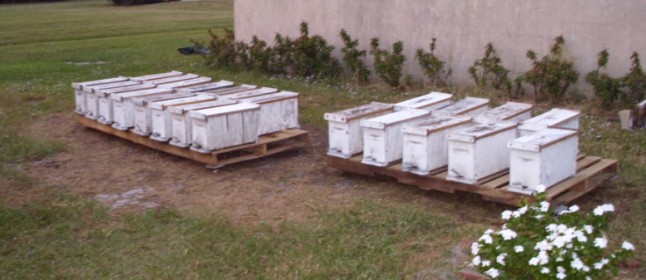
Of course you need the Bees: Acquiring Bees
Nuc (nucleous hive)
Five frames of bees and working queen

Slide 26
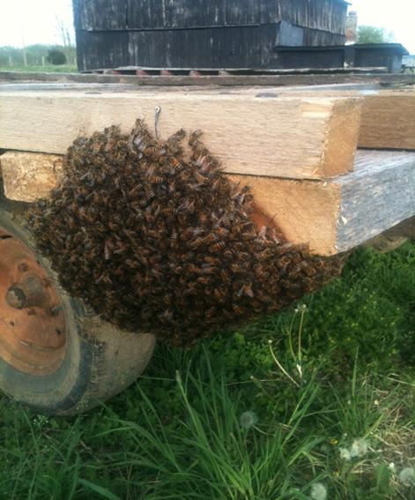
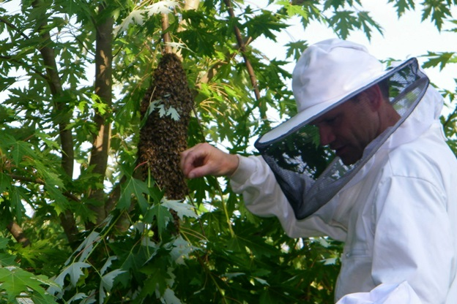
Of course you need the Bees: Acquiring Bees
Swarms

Slide 27
Honey Bee Anatomy

Slide 28
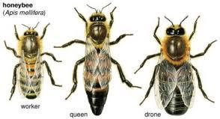
Bee Sexes
Queen
Worker
Drone

Slide 29
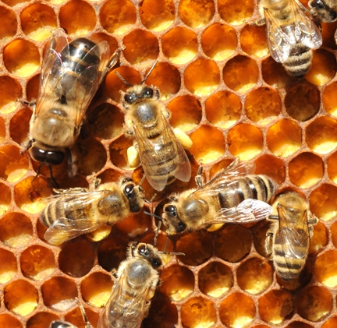
Bee Sexes
Drone (Male)

Slide 30
Bee Sexes Drone Bee
Males
Does not collect (nectar, water, pollen, etc.), nor does any hive duties.
Can not Protect the hive (no stinger)
Only eats and flys to congregation areas to mate with a virgin queen then dies.

Slide 31
Bee Sexes
Worker(female)

Slide 32
Bee Sexes Worker Bee
Does all the work
Collects nectar, pollen, and water, feeds brood, makes wax, builds comb, makes propolis, makes honey, controls temperature of hive, clears the hive of debris and dead bees, feeds the queen, carries her waste out of the hive, protects the hive and more
They are, tireless, relentless, ceasless, selfless, fearless.
They “die with their reigns on”- L.L. Langstroth

Slide 33
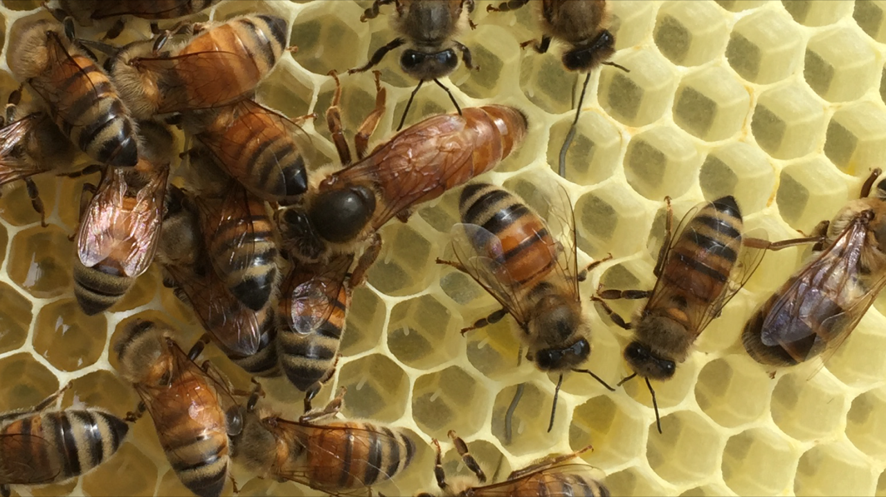
Bee Sexes
Queen

Slide 34
Bee Sexes Queen Bee
The life/ mother of the hive.
Emits Pheremone: keeps hive “queenright”
Determines characteristics of a hive.
Only one in each colony (few exceptions)
She mates with several drones on nuptial flight and never leaves the hive again unless there’s a swarm.
Viable 2-3 years
Decides if egg will become drone or worker bee.

Slide 35
Bee Development

Slide 36
Bee Development

Slide 37
Bee Development
Why is this information good to know?
We can gauge when the queen was last there.
Queen present or not (drone brood only?)
When we might need to add frames
When brood will emerge for quickly boosting weak hive.

Slide 38
Bee Development
Worker Brood
Queen Cell
Drone Brood

Slide 39
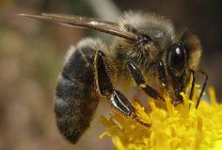
Breeds of Bees
Like any other livestock there are different breeds of bee.
Breed brought to America by colonist
significant winter hardiness
low tendency to swarm
strong drive to collect pollen
high longevity of the worker bees and queen
excellent flight strength even in cold weather
possibly hardiness against Varroa
Have been known to be defensive
Excitable on the frame
German Black Bee
(European Dark Bee)
Apis melifra melifera

Slide 40
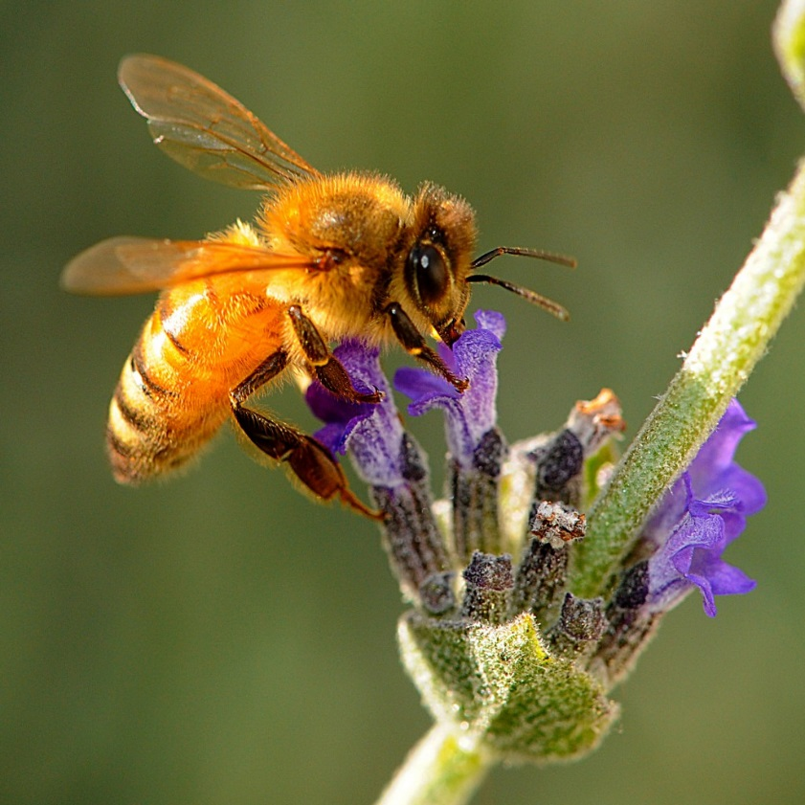
Breeds of Bees
Like any other livestock there are different breeds of bee.
Breed brought to America cica 1859 and favored bee breed in America
shows strong disposition to breeding and very prolific
cleanliness/excellent housekeeper (which some excellent foragers
superb comb builder
shows lower swarming tendency than
industry
gentleness
a willingness to enter supers
high consumption of stores
more prone to drifting and robbing
Italian Bee
Apis mellifera ligustica

Slide 41
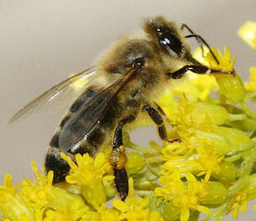
Breeds of Bees
Like any other livestock there are different breeds of bee.
Another widely spread and favored bee breed in America
Considered to be gentle and non-aggressive
Less drifting
Not as prone to rob honey
Able to overwinter in smaller numbers of winter bees
Honey stores are conserved and winters well
Builds up brood fast
More prone to swarming if overcrowded
Low ability to thrive in hot summer weather
Strength of broodnest more dependent on availability of pollen
Unless marked the dark queen is difficult to find
Carnolian Bee
Apis mellifera carnica

Slide 42
Breeds of Bees
Like any other livestock there are different breeds of bee.
originate in the Primorsky Krai region of Russia. This strain of bee was imported into the United States in 1997 by the USAD’s Honeybee Breeding, Gentetics & Physiology Laboratory in Baton Rouge, LA. (Grand Terry Island)
have an innate resistance to varroa mite
have been shown to resist infection by tracheal mites
Buy from members of RHBBA
Russian Honey Bee

Slide 43
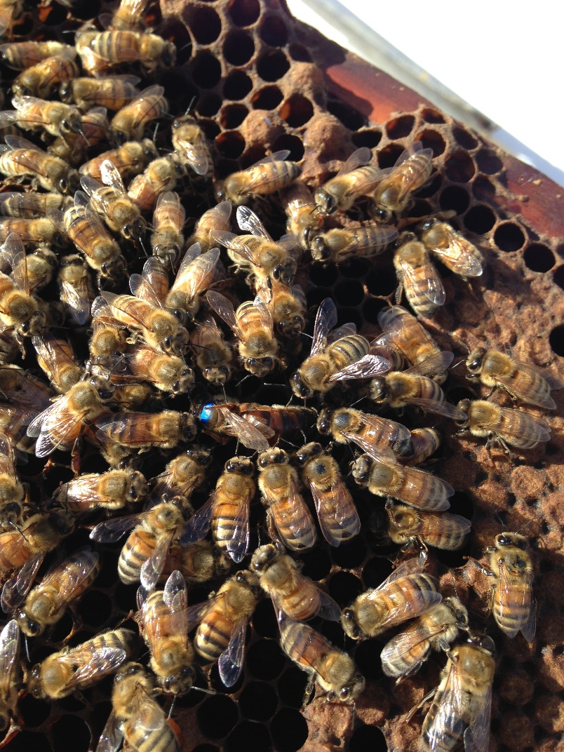
Breeds of Bees
Like any other livestock there are different breeds of bee.
Most commomly bees today are a mix, mutts, a Italian/ Carniolan hybrid.

Slide 44
What are your Expectations?
You most likely will not have surplus honey your first year.
You can not “set it and forget it” (March-November is season)
“We don’t have bees, we ‘keep’ bees”- strong hives prevent a lot, pests, and disease, must treat for varroa mites.
You will not find the queen every hive inspection.
You will make mistakes, but the bees are forgiving.
You will be fascinated.
It will be rewarding.
You will become an entomologist, a botanist, chemist, biologist, gardener, carpenter, photographer, meteorologist, of sorts and more.

